Slide 2

2
2
Lesson 22
Polynomial II

Slide 3
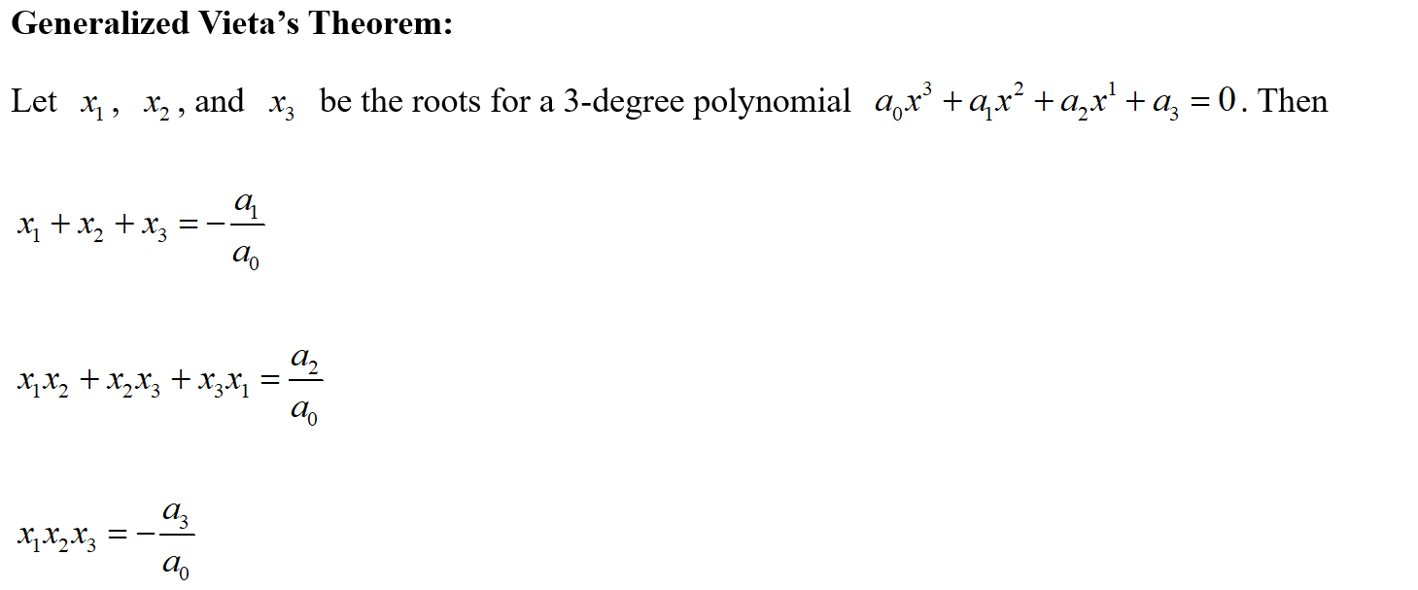
Lead in

Slide 4
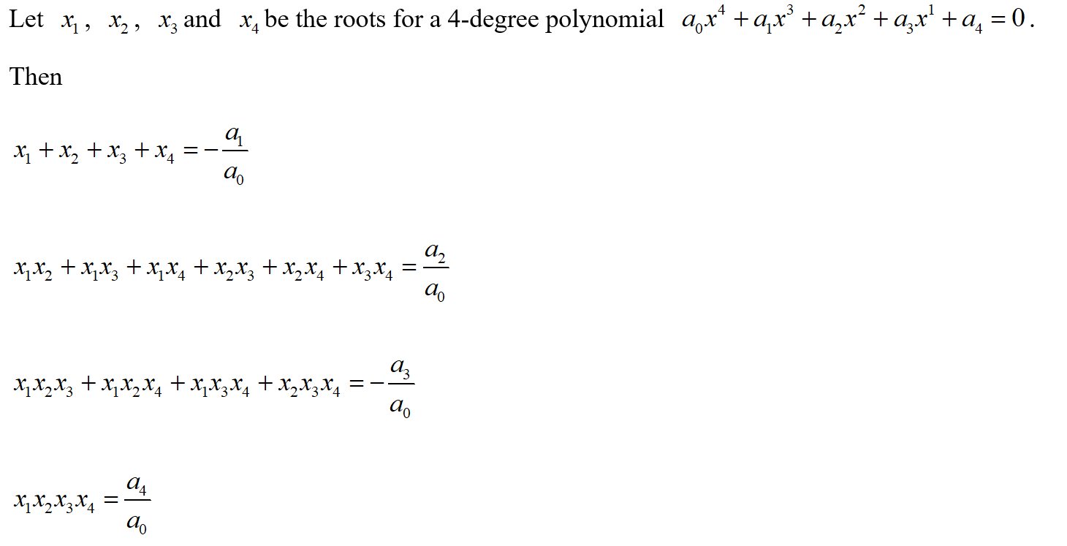
Lead in

Slide 5
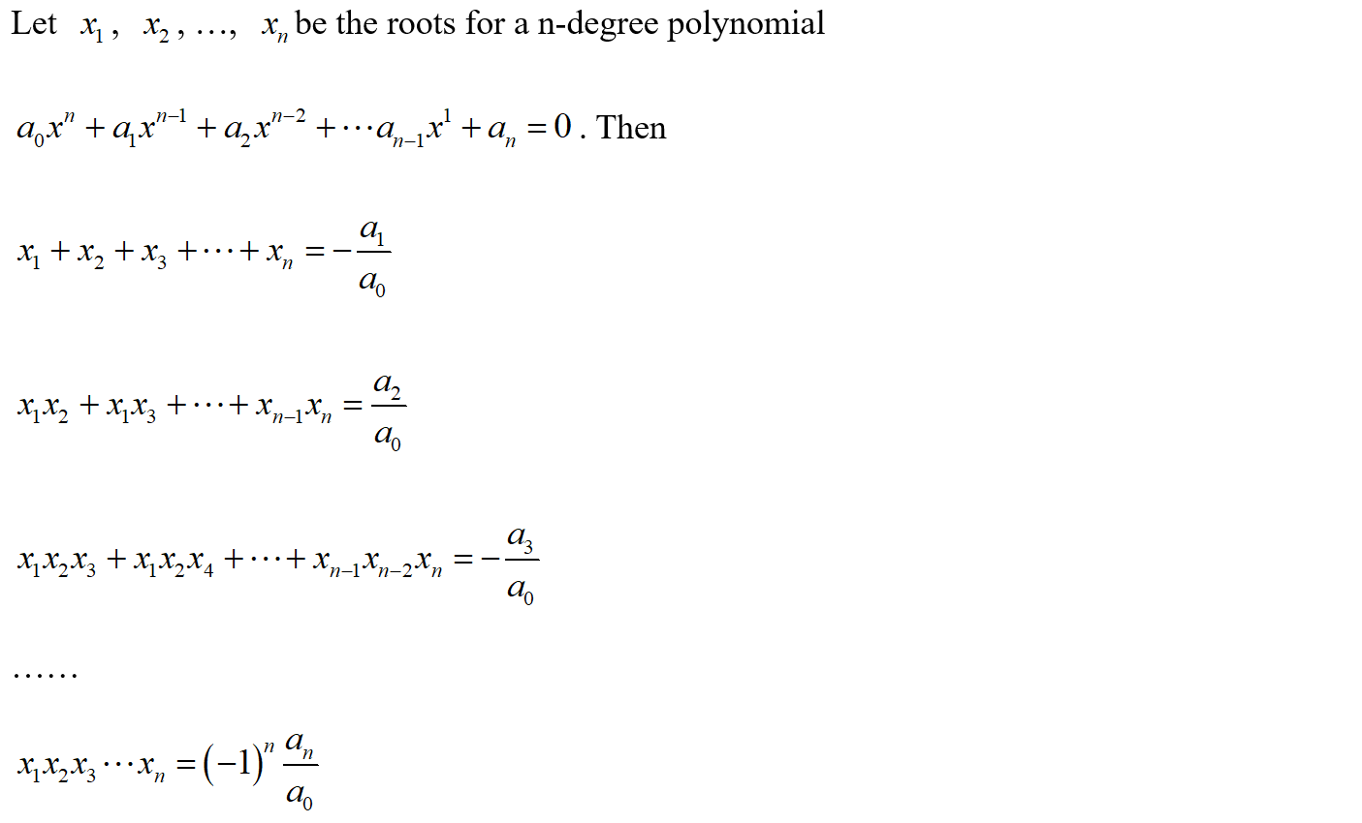
Lead in

Slide 6
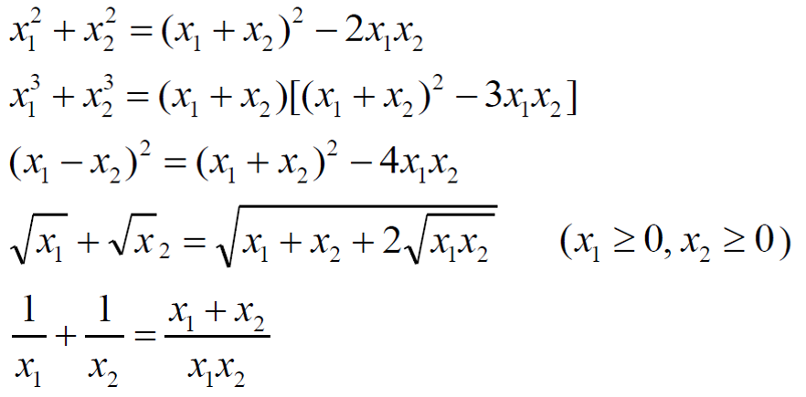
Lead in

Slide 7
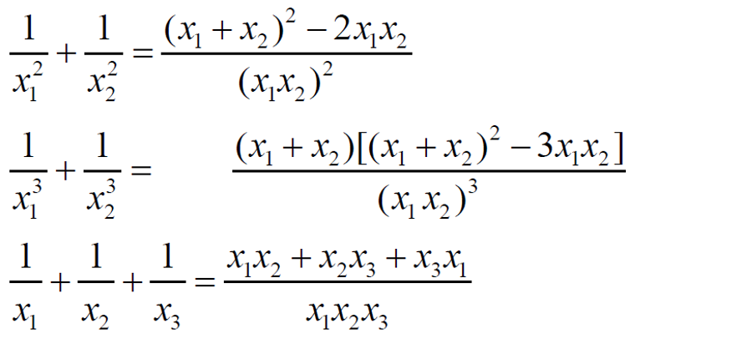
Lead in

Slide 8
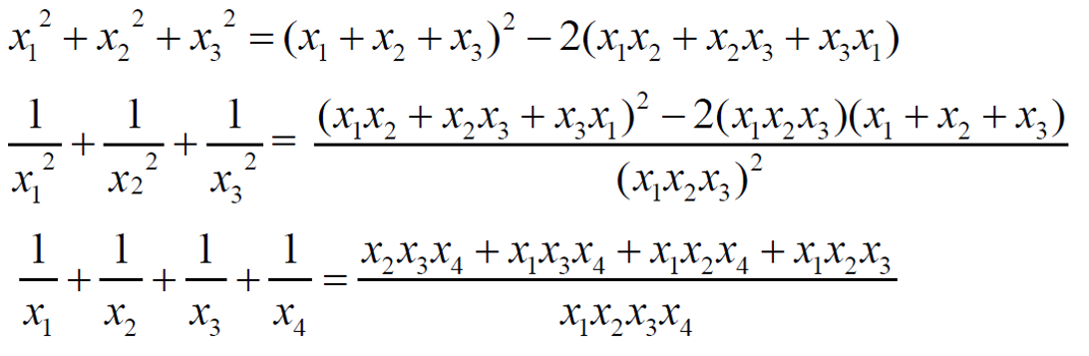
Lead in

Slide 9
Chapter 1
Coefficient and Roots

Slide 10
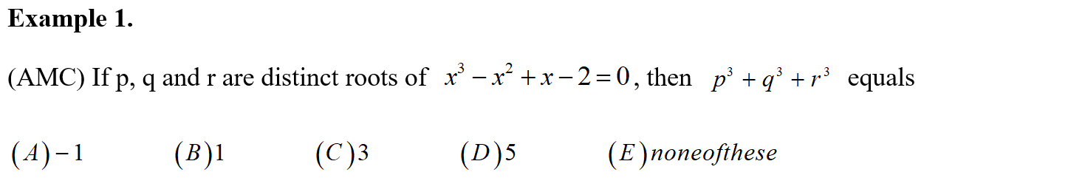
Example

Slide 11
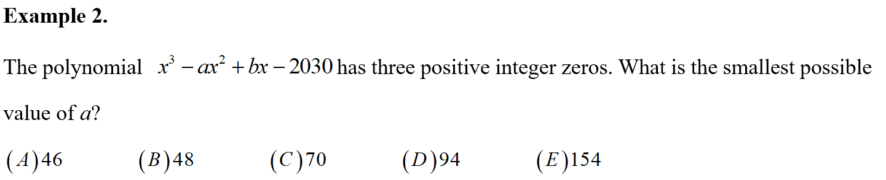
Example

Slide 12
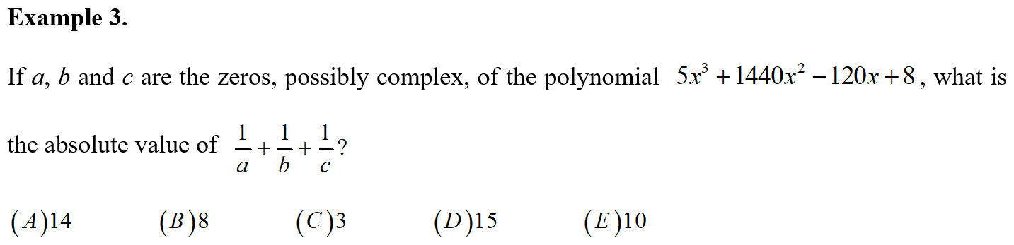
Example

Slide 13
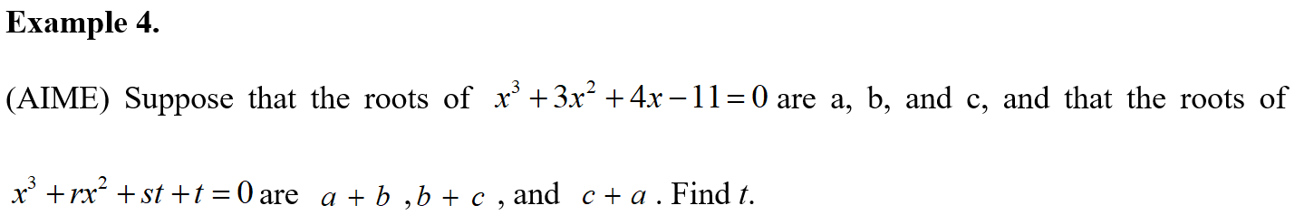
Example

Slide 14
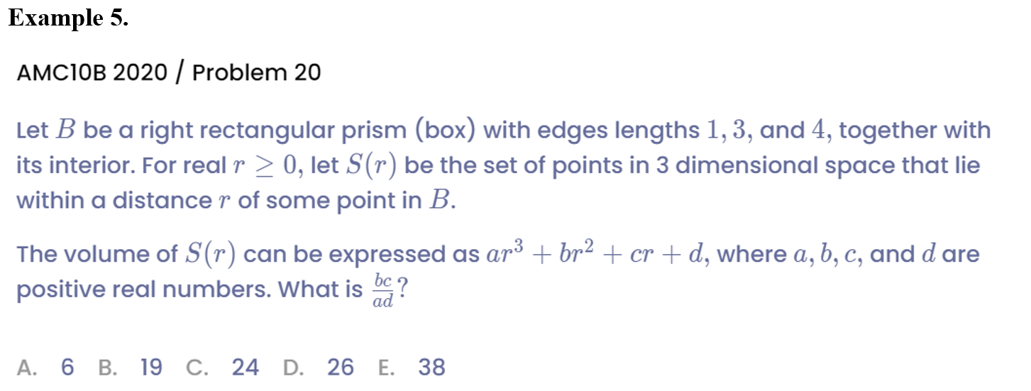
Example

Slide 15
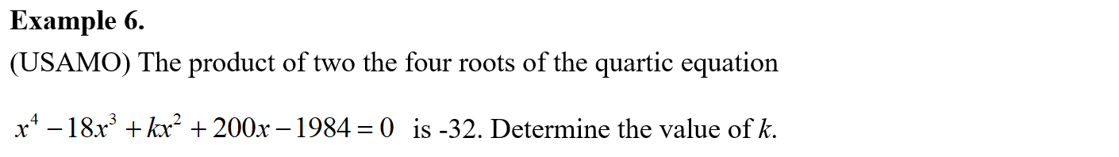
Example

Slide 16
Chapter 2
Inverse Application of Vieta’s Theorem

Slide 17
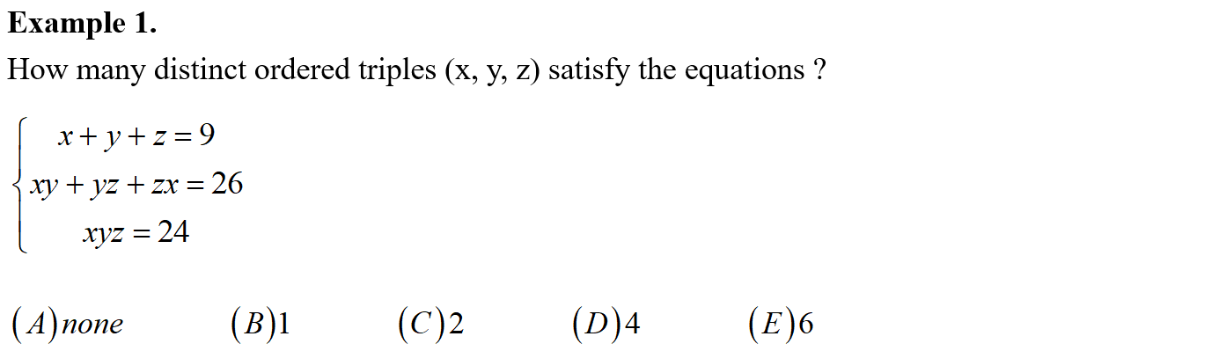
Example

Slide 18
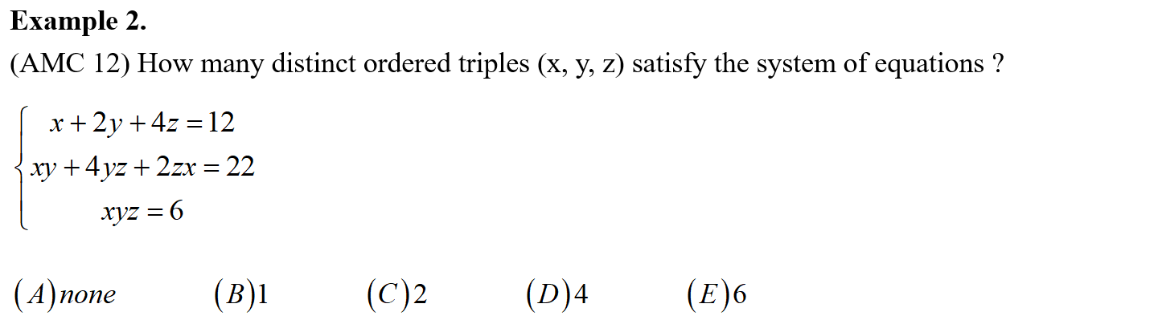
Example

Slide 19
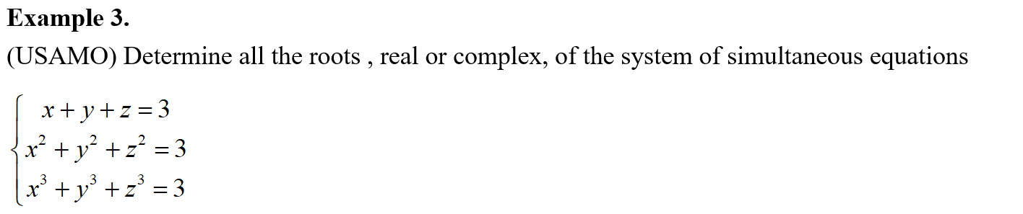
Example

Slide 20
See You Next Time!

